Slide 1
Systematic Testing of a Doujinsoft Application
Xuemeng Wei, Yihang Wang, Jishuo Yang

Slide 2
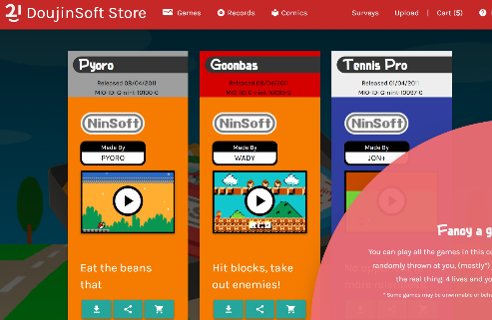
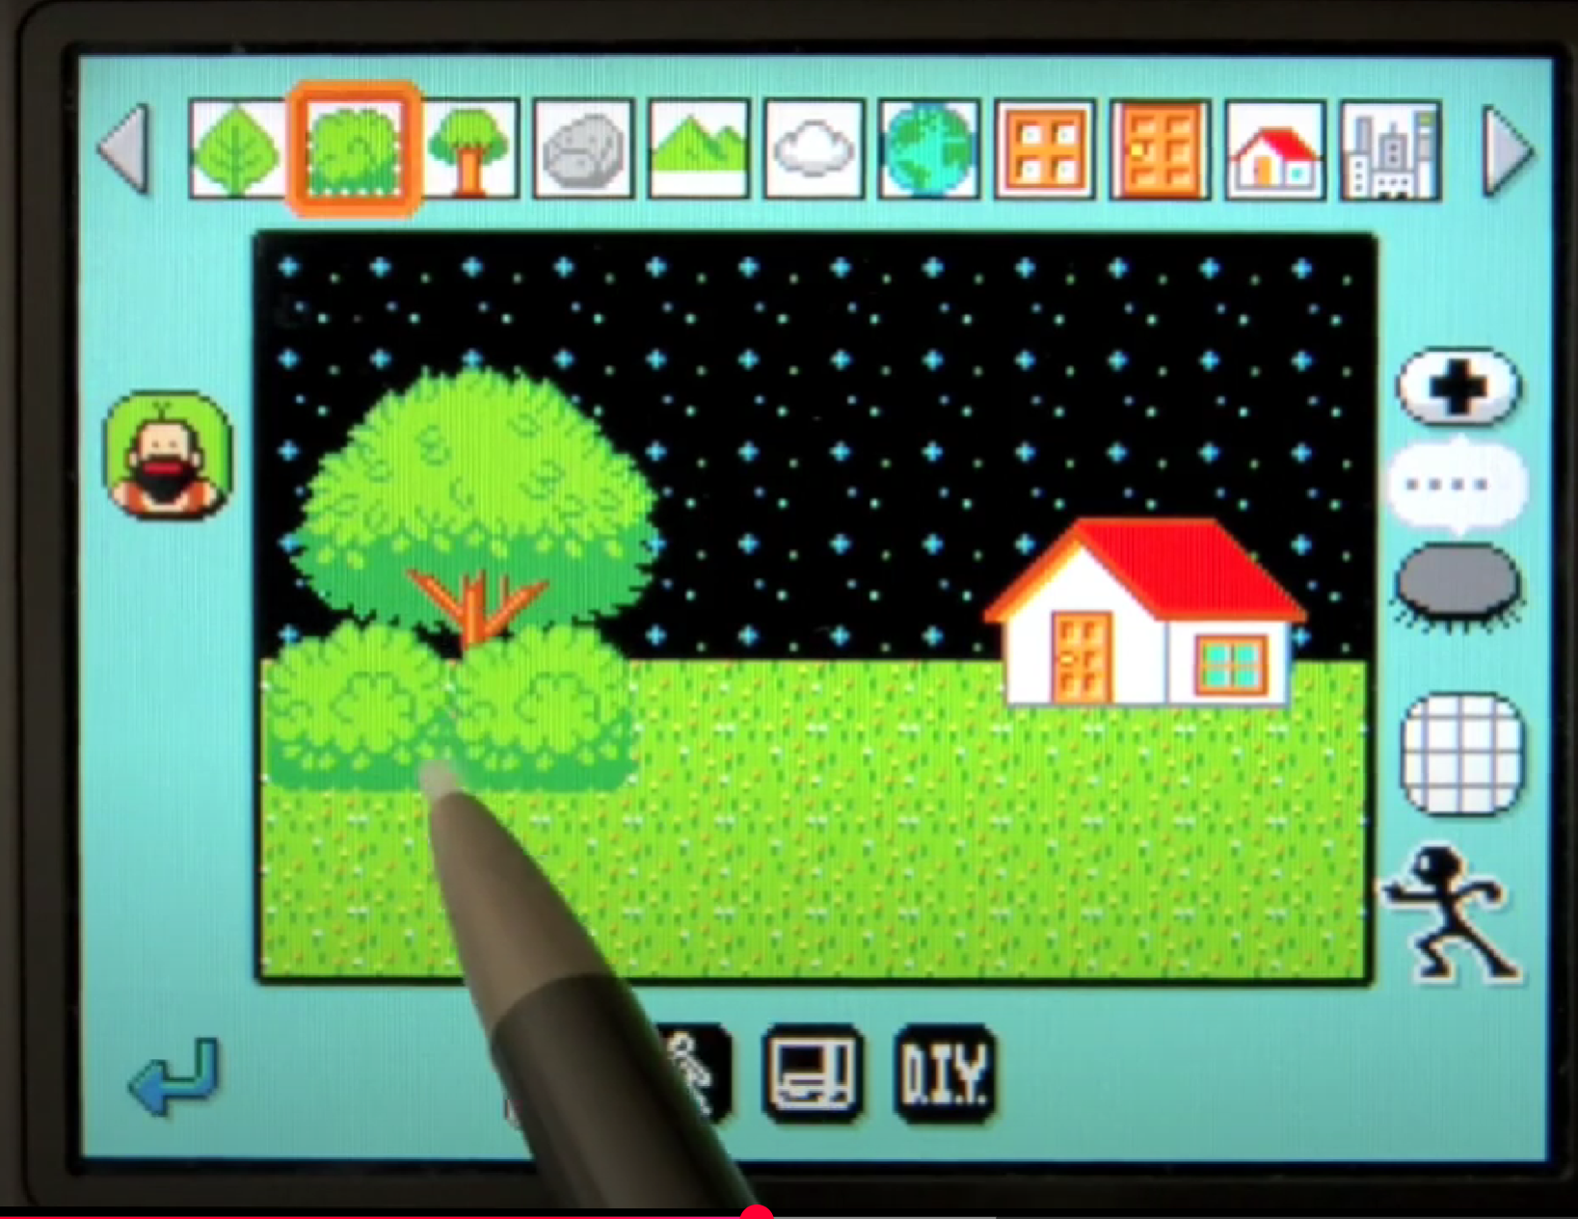
Introduction
What is DoujinSoft?
DoujinSoft is a Java-based web application designed to manage and distribute WarioWare DIY (WWDIY) fan-made content, including games, comics, and music. It acts as a digital archive and shop, allowing users to browse, search, and interact with user-created content.
what platform(s) is it run?
Apache Tomcat (Servlet container).
Docker .
GitHub Codespaces (Cloud-based development/testing).
Active users?
Creators who want to upload .mio game files
Players browsing the archive and content
Admins managing content (developers)

Slide 3
Introduction(cont.)
Technologies
Backend
Language: Java (Servlet/JSP)
Framework: Apache Tomcat (Servlet container)
Database: SQLite
Build Tool: Maven
API: JSON API
Frontend
HTML
MaterializeCSS and JQuery

Slide 4
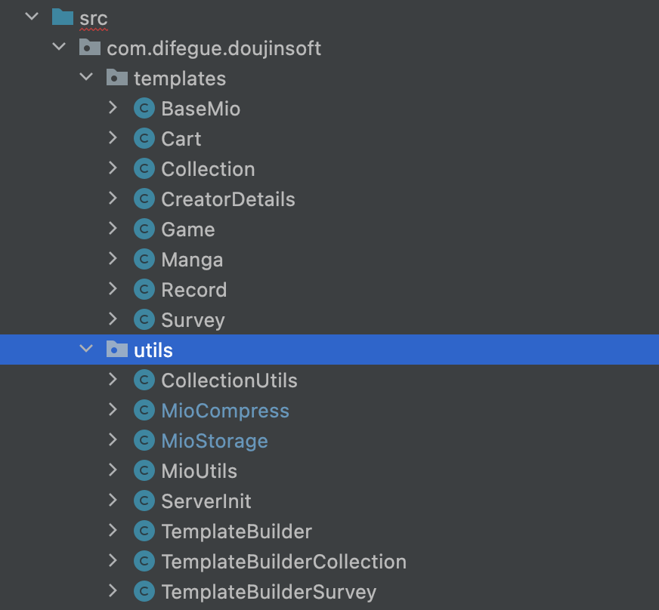
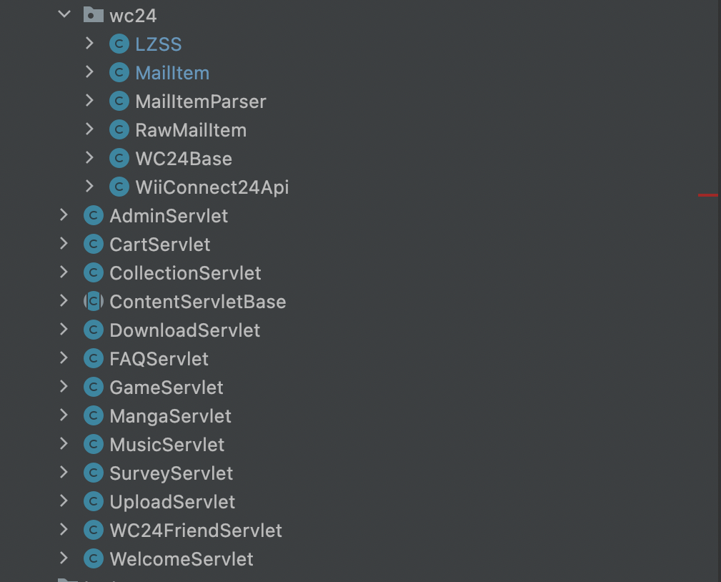
Code structure

Slide 5
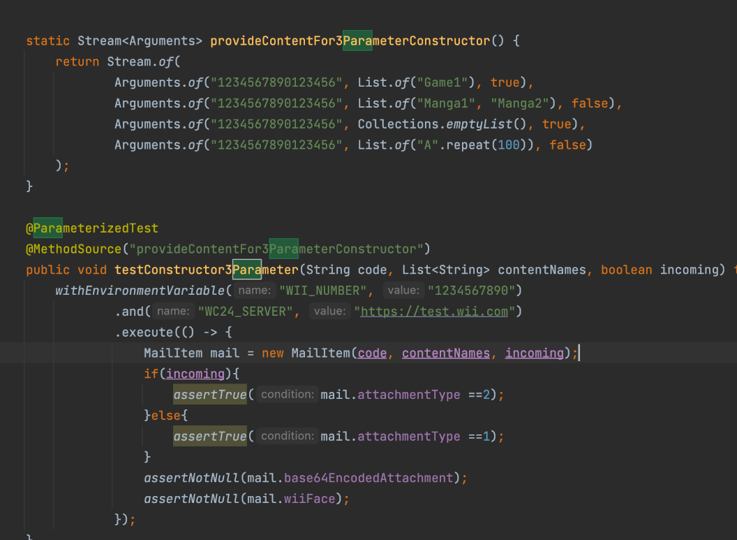
Blackbox testing
Goal: Test based on expected behavior
What we did:
Simulated black-box testing
Equivalence partitioning
Edge cases(null, empty..)
Combined equivalence blocks for ACoC and ECC coverage
Use @TempDir to safely handle temporary files

Slide 6
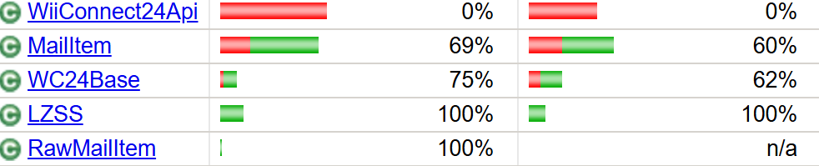
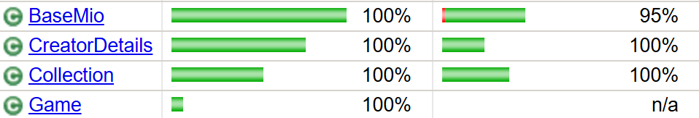
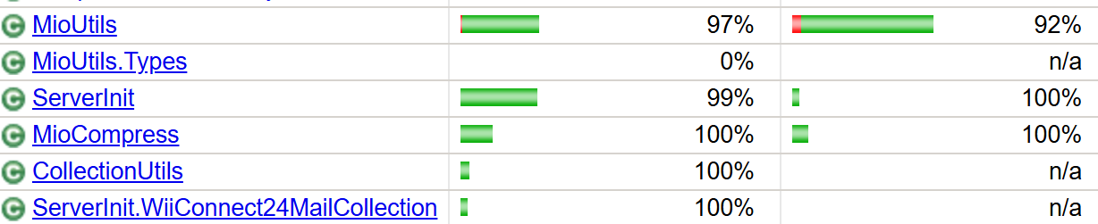
Whitebox testing
Goal: 95% statement coverage & branch coverage
We have complex classes that we are still working on.
What we did:
In this process, mocking is heavily used since many classes need to interact with http/SQLite connection, or have branches that needs an exception to be thrown(where we mock one accordingly, especially when one happens rarely like IOException).

Slide 7
Testing Details – Utils
CollectionUtils class
GetCollectionFromFile(String path)
EP₁: null EP₂: path points to a non-existent file EP₃: path points to a valid JSON file matching the Collection
SaveCollectionToFile(Collection c, String path)
C1: c == null C₂: c != null
P₁: null P₂: path invalid or unwritable (e.g. parent directory missing) P₃: path valid
MioCompress class
compressMio(File orig, File dest, String desiredName)
EO₁: null EO₂: path not exist EO₃: directory not file EO4: file unreadable EO5: valid
ED₁: dest == null ED₂: path not exist ED₃: directory not file ED4: read only ED5: valid
En₁: name = null EO₂: length=0 EO₃: length >=1

Slide 8
Testing Details – wc24
LZSS class : It doesn't implement compression itself—it relies on an external C++ tool (gbalzss.exe or gbalzss) to do the actual work.
LZS_Encode(String filename, String output): Compresses a file using LZSS
LZS_Decode(String filename, String output): Decompresses an LZSS-encoded file
Mock testing: Mocked Runtime and ServletContext to verify OS-specific command generation. (Use System.setProperty("os.name", "Windows 11");
MailItem class:
Simulate presence/absence of required env vars

Slide 9
Integration + GUI testing (Servlet)
Tool: selenium
What we did:
The admin page to add collections
Download buttons under /games, /records, /comics to download the .mio file (they are .miozip on server)
Sharing buttons under /games, /records, /comics to get an unique URL to access one work
Cart buttons to add works to cart
Next button to get next page
Search button to search
Basic access to other endpoints(/home, /about…)
We are still working on this…

Slide 10
API testing
Content list API
Endpoint: /games, /records, /comics
More specially:
GET with no parameters, with or without”format=json”,
“/games?page=2”, “/games?id=some_hash”, “/games?name=Test”, “/games?creator=Author”, “/games?name=Test&creator=Author”, “/games?cartridge_id=some_id”, “sort_by=date”, “sort_by=name”...

Slide 11
API testing
Download API
Endpoint: /download
More specially:
GET /download?type=game&id=some_hash
GET /download?type=game&id=some_hash&preview=true

Slide 12
API testing
(POST)
Upload API
Cart API
Manage API
Still working on it!

Slide 13
Live demo

Slide 14
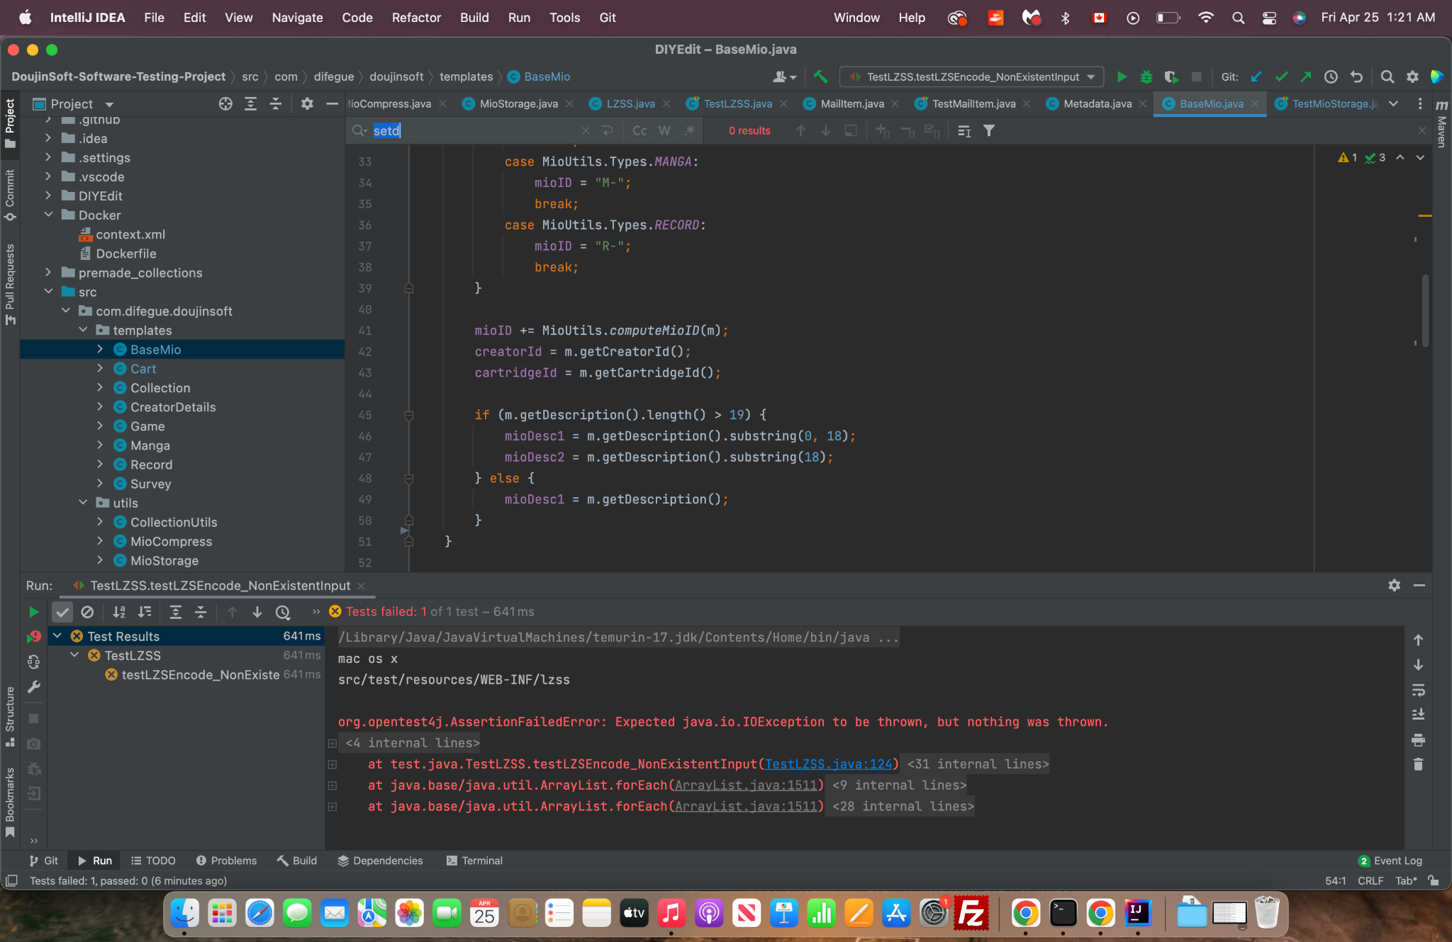
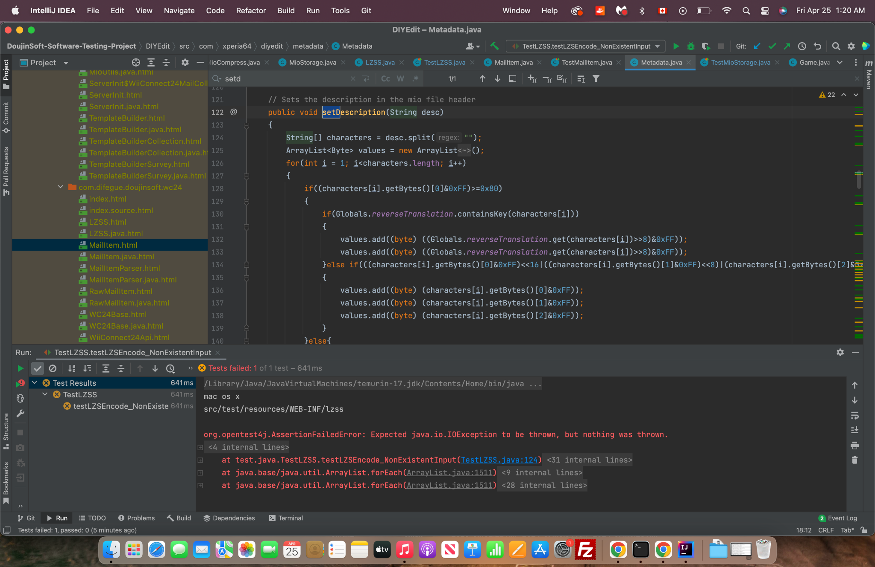
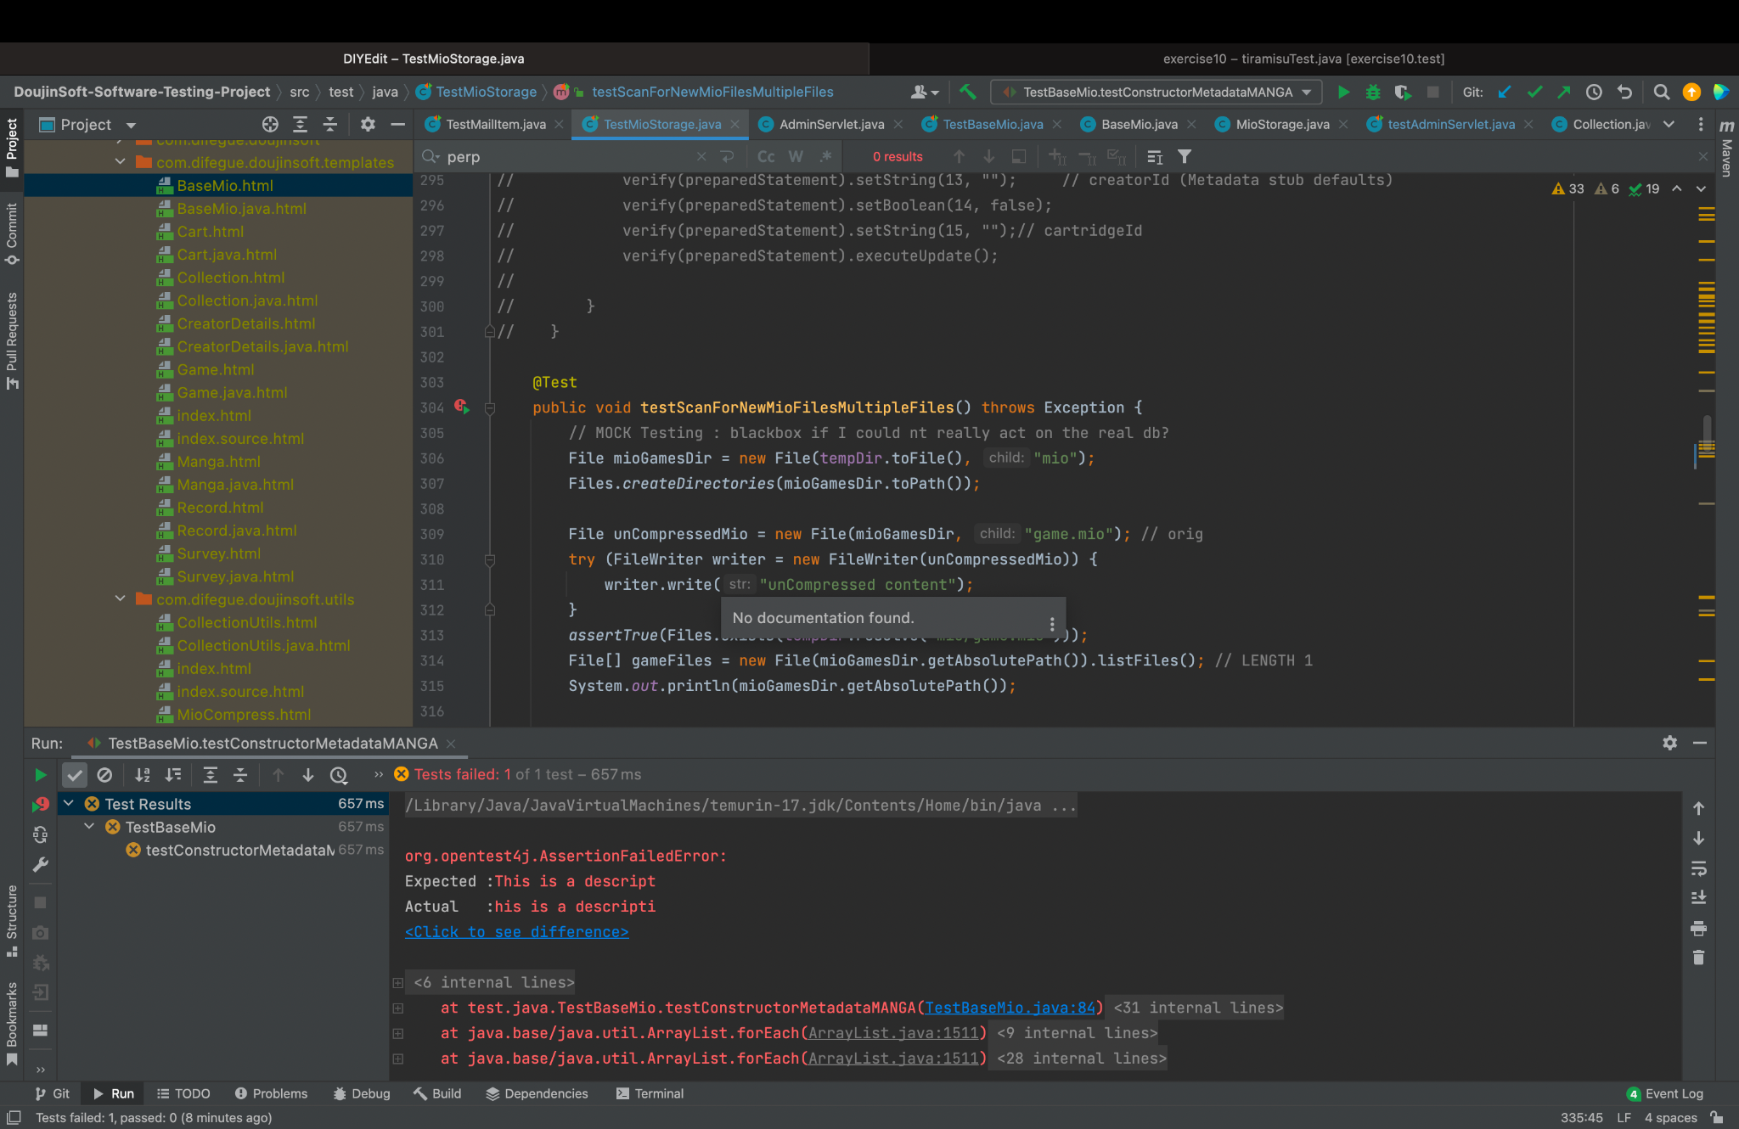
Issues or Errors (BaseMio)
Failure that comes from external package(com.xperia64.diyedit: Metadata)
Highlight the importance of testing, even the program logic looks absolutely right

Slide 15
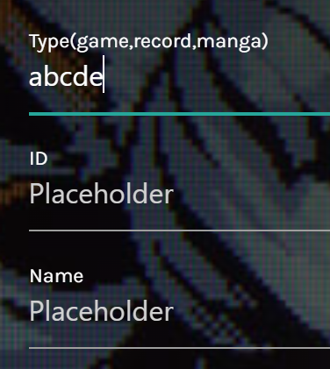
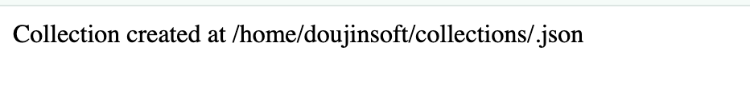
Issues or Errors (AdminServlet)
In Admin page, the website have no restriction on the type of collection. The collection should only be (GAME, RECORD, MANGA). But admin could type anything into the input box.
It should be replaced with a drop-down list to prevent unexpected user input at the client’s side. Although the backend has its logic to return a default value, it’s still not a good practice.
id.json

Slide 16
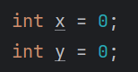
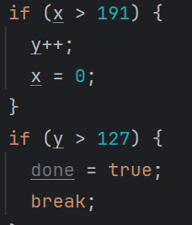
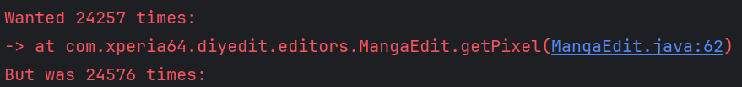
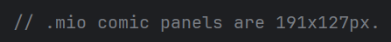
Issues or Errors
getPixel() and setColor()
should run 24527(191*127) times
but actually run 24576(192*128) times
Fault: should be ”x>=191” and “y>=127”
It’s an example showing state error does not necessarily lead to failure:
It reads pixel from a binary file that contains more information than image; the drawing is wrapped using Graphics2D and will not throw during the process and the extra pixel will be cropped out automatically

Slide 17
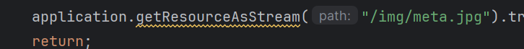
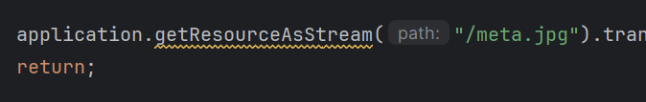
Issues or Errors
Download API (download preview picture)
(/download?type=game&id=some_hash&preview=true)
Expected: return a default jpg(meta.jpg) when id does not exists or type is not defined
Actually: successfully return for record/other undefined types, fail to do that for game/manga
Faults: write wrong path for the block that deals with the game/manga

Slide 18
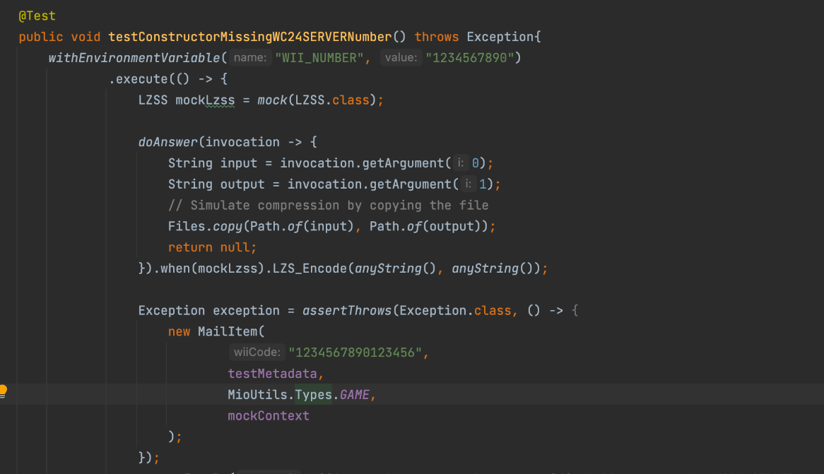
Challenges
MailItem
java.lang.reflect.InaccessibleObjectException: Unable to make field private static final java.util.HashMap java.lang.ProcessEnvironment.theEnvironment accessible: module java.base does not "opens java.lang" to unnamed module @548ad73b
How to mock different environment variables? → use junit-pioneer or system-lambda
Mock static method and constructor? → Mockito-inline (it becomes the default mock maker after Mockito 5.0)
a method is passed asynchronously (like a Runnable to a scheduler) and can’t be called directly → use ArgumentCaptor to capture the method

Slide 19
What we learnt
Strength skills on black box, whitebox, Integration test, GUI, API testing
Environment variable management (SystemLambda for safe env-var mocking in tests)
External Process Integration (Runtime.exec(), System.setProperty)
Advanced mocking techniques (static mock)
TempDirectory for testing files compression safely

